Slide 1
James A Robertson and Associates
Effective Strategic Business Solutions
Why your ERP is NOT delivering and how to FIX it
(The Critical Factors in ERP Investment Success)
6. The Missing Link –
Strategic Engineered Precision Configuration™
Strategic Engineered Precision Taxonomies™ and Configuration
Dr James Robertson PrEng
Copyright 2004 through 2011
James@JamesARobertson.com
Notes:
NB remember to have a chair to stand on
Make sure to take the CRITICAL FACTORS BOOK with you
An engineer with a PhD in engineering

Slide 2
A word of caution
This presentation may seem rather strange
In fact, you might think that I have got things upside down ☺
Please think laterally because, just maybe, I am seeing something different AND valuable ☺

Slide 3
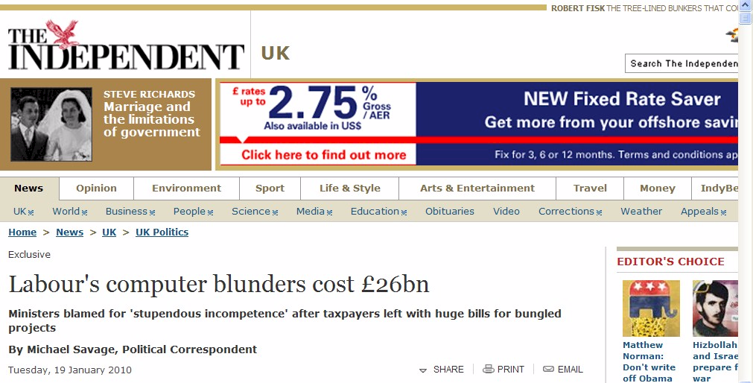
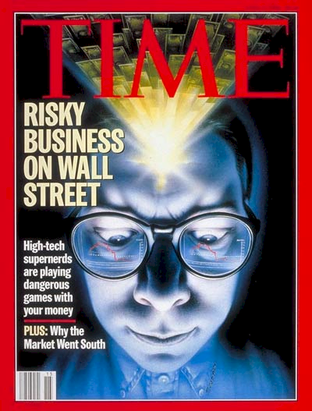
Failures are increasing
The threat and therefore the opportunity is huge
Including clinical integration project

Slide 4
One of the classic business problems of this age
We have spent a FORTUNE on this computer system and I.T. tell me it will take two years and another few million to get what I want BUT the transactions are being processed already

Slide 5
A classic practical example
CEO of very big listed corporation in Johannesburg
With very big installation
Of very big brand ERP
Used in advertising
“At the executive level I would rate my systems at 1/10”
“At the operational level I would rate my systems at 7/10”
1/10
BUT even that is being done with smoke and mirrors!
7/10

Slide 6
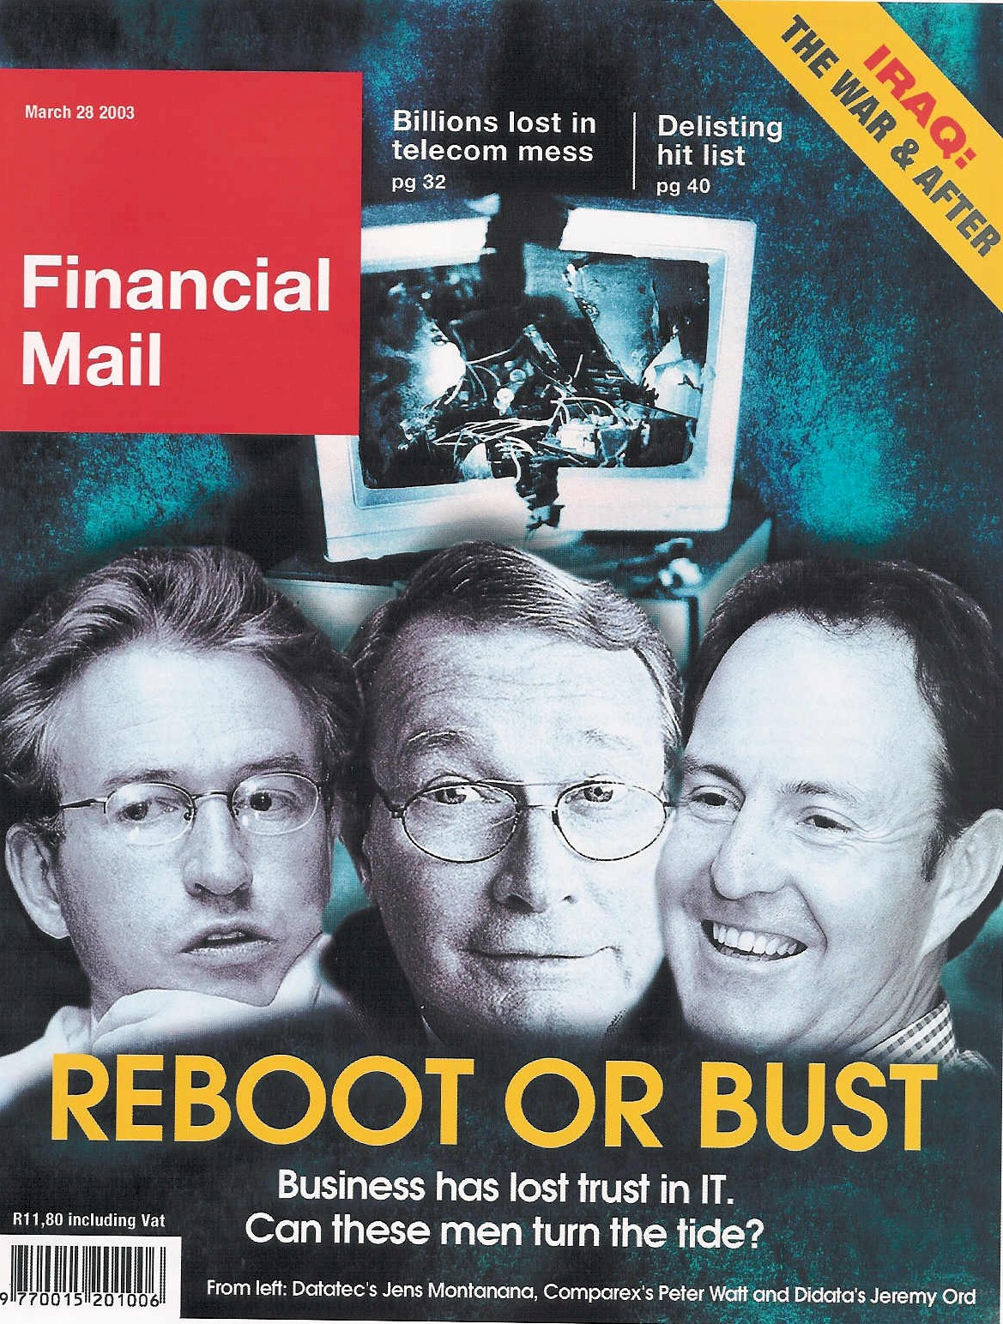
ERP -- an industry in crisis
R e c a p
“19 out of 20 ERP (integrated business information system) implementations do NOT deliver what was promised” – based on a survey of executives

Slide 7
To avoid misunderstanding → let me stress that I REALLY believe ERP can and should add great value to business

Slide 8
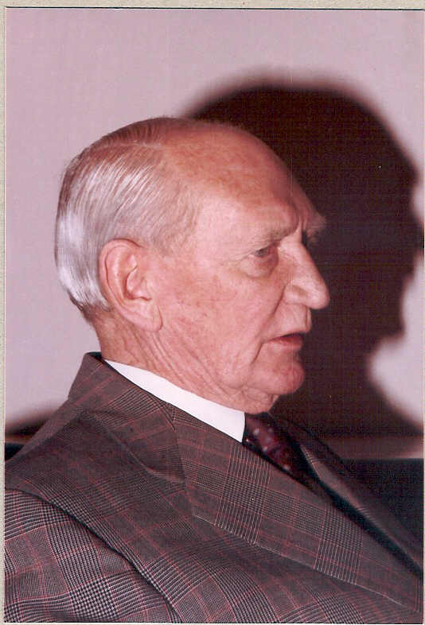
A classic example of IT value
Double turnover in 12 months
Through BETTER DECISIONS
I am successful because I make the right recommendations more than 51% of the time
Simple manual models were computerized
Computed faster and therefore many more scenarios
Creative business concept
Better advice in less time to more clients
Doubled turnover in 12 months
In 1982
Through supporting BETTER decisions

Slide 9
Precision content engineering Key driver of successful implementations
Days spent with CFO designing the codes -- first year massive improvement in management information, one less clerk, financials signed off without qualifications six WEEKS after month end versus six MONTHS the previous year.
Software designed in two days, built in ten, ten days spent with a director of the company consulting with other directors and managers to design codes -- four clerks instead of 12, an extremely wide range of management information, captured 90% of the data instead of 10%.
Six days spent with CFO’s of operating divisions and major subsidiaries to identify core economic drivers for a group of over 200 companies and develop the headlines of the group consolidation ledger -- dramatic improvement in management information.
The subject of this section is of critical importance -- it is the content that makes the difference

Slide 10
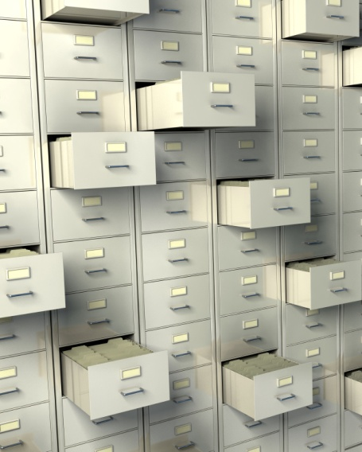
What is an ERP?
“Enterprise Resource Planning” = ERP Systems
? or ?
"Integrated Business Information Systems” = IBIS
= all the information “repositories”
= databases
= tables
= lists
= filing drawers / folders
real world items that require description and management
+ the numerical computations, workflow and other activities that are executed with the numbers (and text) stored in these repositories
ALL of which can be done by human beings -- including making a mess!

Slide 11
IBIS = Integrated Business Information System
But there really is NO SUCH THING as an ERP system (Enterprise Resource Planning)
Many organizations do their resource planning in industry specific software, frequently NOT from the ERP vendor
And configure badly = “sloppy configuration”
And therefore are unable to integrate properly
So HAVE to customize to compensate
And still need spreadsheets – Excel is the most widely used software development tool in the world because we LIE about it
Data warehouses are a necessity NOT a luxury, you SHOULD have one
So what do we have?
IBIS = ERP Plus

Slide 12
IBIS – what every company REALLY has ☺
Data warehouse and BI
Spreadsheets
Brandname ERP = FRED
Industry specific package
Etc, etc, etc
Custom-ization
In-house custom development

Slide 13
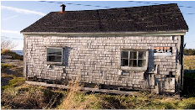
Strategy defined
The essence of why an organization exists and how it thrives
Die fast
Thrive
Tactics – Doing things right ➔
Die slowly
Survive
Strategy – Doing the right things ➔

Slide 14
The “Strategic Process”
Receive report of a problem
Ask for information
Make some phone calls
Discuss with some colleagues
Or whatever …
or
Find a nice conference venue
Go away and talk
Write a report
Or whatever …
Critical strategic thinking leading to high value decisions
Like silver bullets the “Strategic Process” does NOT exist
Process is fundamentally OPERATIONAL
Operational workflow = process leading to operational efficiencies

Slide 15
Top down versus bottom up design
Top Down – Strategy Focused
Bottom Up – Process Focused

Slide 16
Defining terms – Business Process
“A business process or business method is a collection of related, structured activities or tasks that produce a specific service or product (serve a particular goal) for a particular customer or customers. It often can be visualized with a flowchart as a sequence of activities with interleaving decision points or with a Process Matrix as a sequence of activities with relevance rules based on the data in the process.”
i.e. WORKFLOW!!!

Slide 17
Pulse measurement
A concise diagnostic investigation into why an ERP or other IT investment is NOT delivering what was promised
Prescription of what is required to solve the problems
Been doing them since 1990 – dozens and dozens
Process obsession is increasingly manifesting as a MAJOR cause of failures and sub-optimal outcomes
In fact business process is close to irrelevant when it comes to designing HIGH VALUE ERP solutions

Slide 18
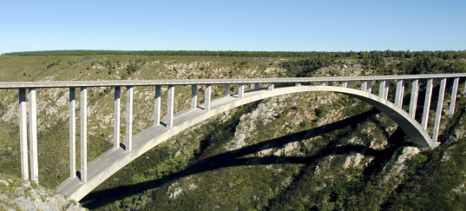
This is NOT in a Text Book
Engineering
Zoology
Document cataloguing
Military combat planning
Methods of structured software design
Strategic planning techniques
etc
Dozens of pulse measurements – what does NOT work and what does
Cataloguing and analysing findings
Trial and error
Never did process BUT produced excellent results
Then a client told me I was incompetent because I did not do process ☺
Proven conclusively process close to irrelevant for ERP implementation
Process is at BEST an output

Slide 19
Motivating quotes
“James you produce exceptional high value outcomes in ridiculously short time frames at ridiculously low cost”
“James you transformed what would have been a pedestrian, poorly thought out system, into an ERP that is already functional and will ultimately transform our analytics and IT offensive capabilities" -- Robert Priebatsch, Robert Priebatsch, Chief Executive, African Sales Company
“James you have provided some key pieces of my jigsaw puzzle, now I understand why Business Systems Implementations are failing”
All sorts of opposition
In fact …
Some very contradictory feedback ☺

Slide 20
Some process obsession examples
Big brand ERP implementation completely stalled
Project stalled
Took over leadership and brought to completion in five months
Thick file of Business Process diagrams = flow charts
Put on the shelf to gather dust
CEO of implementer could not tell me how the process diagrams contributed to the final outcome
i.e. process a complete waste of time and money!

Slide 21
Some process obsession examples
Big brand ERP, client insisted on process but consultant could NOT find out what the process was
Creditors process
Two creditors clerks, two completely different process descriptions
Two weeks later neither agreed with what they said before
i.e. process a complete waste of time and money and caused confusion!

Slide 22
Some process obsession examples
Big brand ERP, big brand implementer
Project stalled and restarted
Running for three years and NO DELIVERABLE!!!
Thick files of process documentation
Swimlanes, user stories, flow charts
You name it they had it
Except a deliverable
i.e. process a complete waste of time and money and caused massive delays!

Slide 23
The brutal truth
Real processes are much more diverse and more complex than most people realize
probably at least seven creditors processes
Processes are seldom if ever defined in most businesses
We hack it with the way the people we hire do it
Process is only relevant IF all the rest of the business is highly optimized
Process is a DESIGN OUTPUT NOT an input
There is NO SUCH THING as the Strategic process
Provide quality information on which to base quality decisions – one really good strategic decision could repay the entire investment!
One really BAD decision can destroy the business

Slide 24
Define: Strategic business function discovery
Strategic – the essence of the business and how it THRIVES
Business function – the WHAT we DO – eg Creditors Function – high level, broad concept – NOT a process
Discovery – gain understanding
Then
Precision Configuration

Slide 25
Define: Strategic Engineered Precision Configuration
Configuring the ERP so that it PRECISELY models the real world
The goal is that any executive, manager, supervisor or operator can look at the configuration and say “YES, this IS my business”
Founded on master data taxonomies – structured semantic content
Coupled to custom business specific attributes
Supplemented by highly structured record level configuration
Supporting small pieces of clever custom development that add huge value and create huge strategic and operational opportunities
An ERP is a huge precision data processing factory
Feed it precision data

Slide 26
Why invest in a new ERP / IBIS? Or any IBIS?
1. Because everyone else has one?
2. Because the one we have does not work very well?
3. Because the one we have is more than five years old?
4. So that we can get better strategic (thrive) information?
5. So that we can get better tactical (thrive) information?
6. So that we can get better operational (thrive) information?
7. So that we have more effective delegation and governance?
8. So that we can become more efficient?
9. Head count reduction and audit fee reduction?
? X No
? X No
XXX NO!!!
Yes
Yes
Yes
Spinoff
Spinoff
Spinoff
To support better decision making

Slide 27
How do you unlock IBIS value?
Value is unlocked through effective delivery of information that is intuitively fundamentally meaningful
Packaged in a way that the computer system APPEARS to be intelligent
Presented through:
reports
graphs
dashboards
advanced statistical techniques
advanced economic analysis
other advanced techniques of information presentation, analysis and interpretation
Resulting in MUCH BETTER strategic, tactical and operational decisions that manifest in improved organizational profitability, growth, impact, etc
High value business decisions

Slide 28
What is the core requirement for any IBIS?
I can get answers to any question for which I can reasonably expect there to be answers in the databases that I KNOW my organization has
Easily and quickly and without major effort on the part of any staff member or contractor
The RIGHT information at the RIGHT place at the RIGHT time in order to make the RIGHT decision
High value intelligent information

Slide 29
How is value created
Value is created by business actions that deliver on the essence of why the organization exists and how it thrives
Value manifests through increased profitability, growth, acquisitions, job satisfaction, fulfilment of the strategic vision
The consequence of intuitive, intelligent, informed leadership business decisions – thrive decisions
Such decisions are facilitated, accelerated and enhanced through access to more intelligent, meaningful and relevant information
Answers to the questions I have not yet thought to ask
Such “intelligent information” is assembled as a consequence of high level strategic and executive level input into the design of the data CONTENT – taxonomies designed to catalogue every conceivably relevant classification ahead of time
High value intelligent content design

Slide 30
Strategic Engineered Precision Taxonomies™ (SEPT™)
The definition of information content
in a way that is structurally (taxonomically) fundamentally meaningful to human beings who understand the business
and the translation of this content into structured codes which faithfully and accurately reflect human understanding of the REAL WORLD in a way that the computer can manipulate
with minimal human intervention
so that the computer system appears to be intelligent

Slide 31
Three alternative ERP value scenarios
2. Precision configuration based on precision taxonomies
3. Strategic customization
Based on SEPC&T™
30+
X 10+
This is the ONLY valid scenario but it seldom occurs
1. Current view of best practice
X 7
20
X 3
10
Relative value
0
0
0

Slide 32
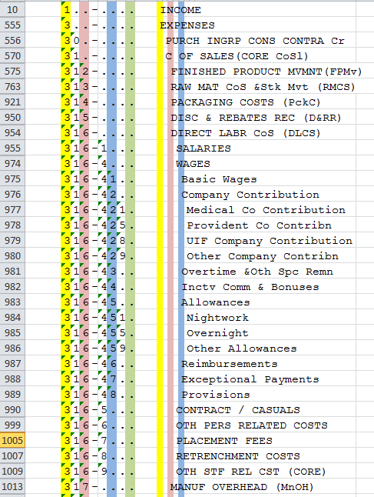
Taxonomy defined
Logical word (semantic structure)
Precision vocabulary of preferred terms
Conveys understanding between humans with relevant knowledge and experience
Once linked to a precision code scheme the most important communication mechanism between computers and people
An art and a science
Once it is right it is OBVIOUS ☺

Slide 33
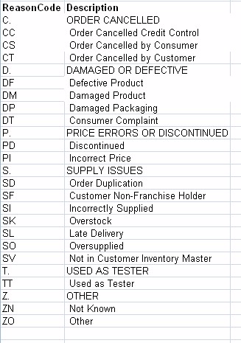
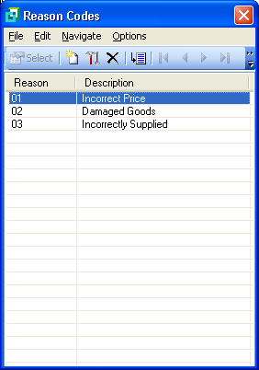
Taxonomy example
Example of credit note
reason codes – actual case
Strategically aligned credit note reason codes

Slide 34
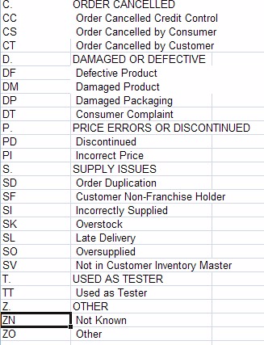
Taxonomy relevance
Essential to effective operational and strategic use of business software
Nearly ALL validation lists (drop down lists), chart of accounts, etc
Large body of expertise – Botany, Zoology, military filing, Library Science, Information Management, etc
Unknown to many (most?) IT professionals and business people

Slide 35
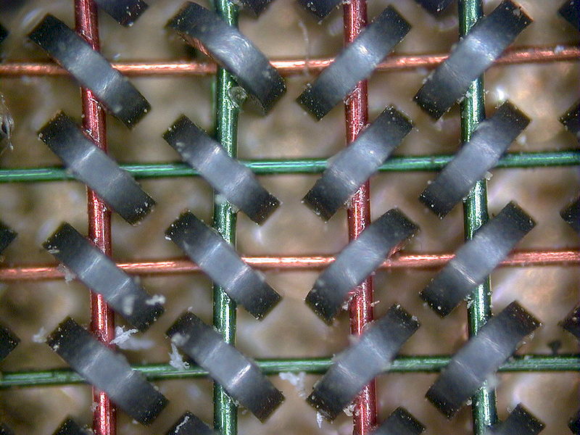
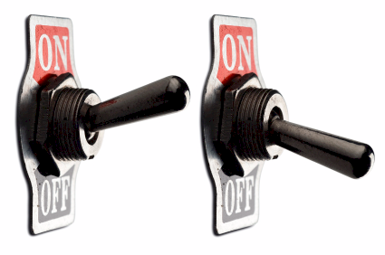
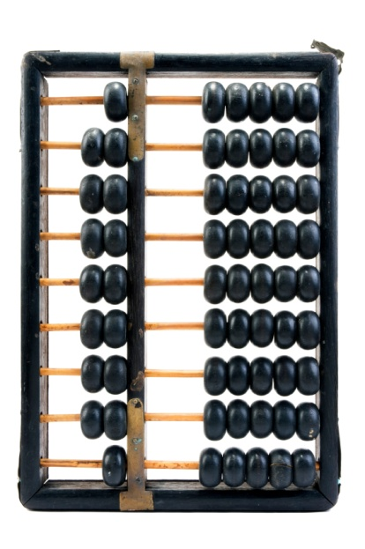
A computer is
an adding machine / calculator
0
1
1+1=10
1+1+1=11
1+1+1+1=100
Called a “bit”
8 bits make a byte
2 bytes make an ASCII character
A= “41” hex
0
1
Notes:
DHL, Prochem,

Slide 36
Coding taxonomies
Computers only understand binary
The code is a unique binary pattern that corresponds to the structured English taxonomy
The only way the computer will appear to be intelligent
Results in “intelligent data”
Standard conventions
Indents and trailing periods
2. Capitalization
3. Other standards and conventions

Slide 37
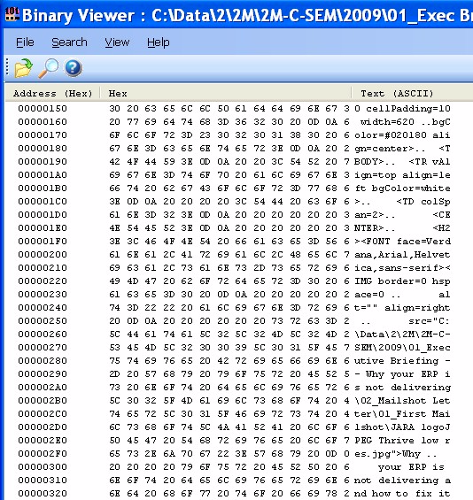
Software and data
text -> hexadecimal -> binary
All for US ☺
Notes:
DHL, Prochem,

Slide 38
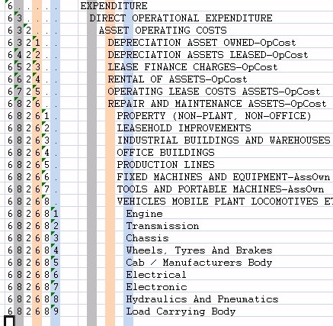
What is a general ledger?
Notes:
You understand the technology well enough to manage it
VERSUS ABDICATION / DISEMPOWERMENT
FAST
Computers are simply adding machines or switches that switch left or right – 0 or 1 – on or off – called binary – they just do things very quickly, everything you see is a pattern of 0’s and 1’s – a very fast Abacus – the content is always the same – binary code -- source code is simply instructions for the bricklayer
Wordprocessors are typewriters -- The typing story – so why do you want to spend thousands of Rands upgrading your typewriter every few years? -- Databases are filing cabinets or warehouses -- General ledgers are large books that book keepers write in – networks are postal systems – large frame pictures cost a lot and take up lots of space

Slide 39
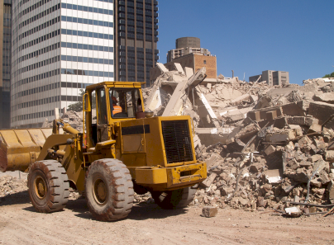
What is a general ledger for?
?
X
?
X
R/$
Notes:
You understand the technology well enough to manage it
VERSUS ABDICATION / DISEMPOWERMENT
FAST
Computers are simply adding machines or switches that switch left or right – 0 or 1 – on or off – called binary – they just do things very quickly, everything you see is a pattern of 0’s and 1’s – a very fast Abacus – the content is always the same – binary code -- source code is simply instructions for the bricklayer
Wordprocessors are typewriters -- The typing story – so why do you want to spend thousands of Rands upgrading your typewriter every few years? -- Databases are filing cabinets or warehouses -- General ledgers are large books that book keepers write in – networks are postal systems – large frame pictures cost a lot and take up lots of space

Slide 40
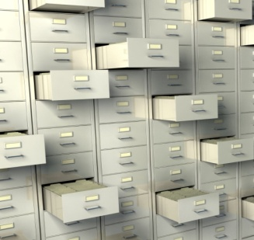
Integrated system
(look-up and posting)
Precision fundamental strategic taxonomies – the missing link
Plant
Management
Projects
Inventory
Production Planning
Human Resources
General Ledger
Etc, etc, etc
Asset Register
Accounts Payable
Cash Book
Accounts Receivable
Financial amounts R / $/ etc
People related names, rates, etc
Production related shifts, batches, etc
Notes:
You understand the technology well enough to manage it
VERSUS ABDICATION / DISEMPOWERMENT
FAST
Computers are simply adding machines or switches that switch left or right – 0 or 1 – on or off – called binary – they just do things very quickly, everything you see is a pattern of 0’s and 1’s – a very fast Abacus – the content is always the same – binary code -- source code is simply instructions for the bricklayer
Wordprocessors are typewriters -- The typing story – so why do you want to spend thousands of Rands upgrading your typewriter every few years? -- Databases are filing cabinets or warehouses -- General ledgers are large books that book keepers write in – networks are postal systems – large frame pictures cost a lot and take up lots of space

Slide 41
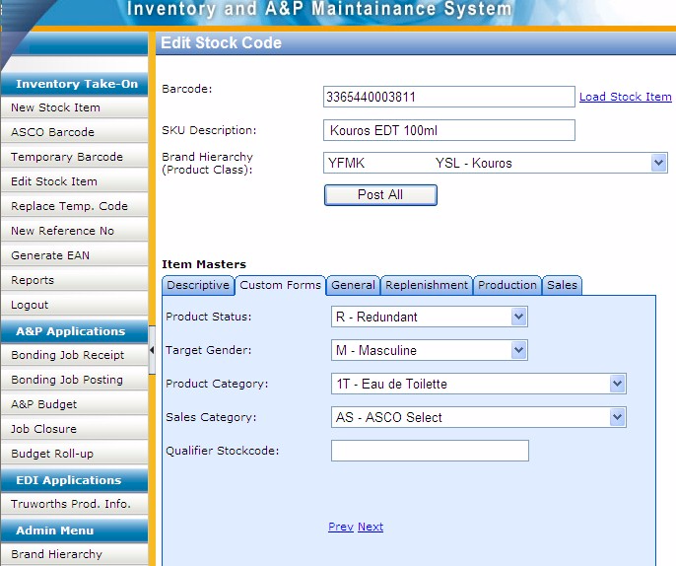
Custom data entry screen with custom taxonomies
Notes:
DHL, Prochem,

Slide 42
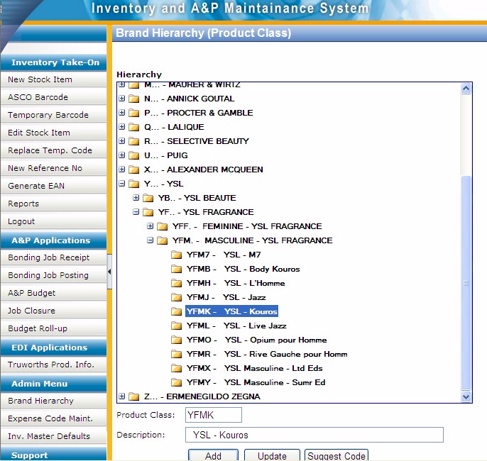
Custom code maintenance development for client specific taxonomy
Notes:
DHL, Prochem,

Slide 43
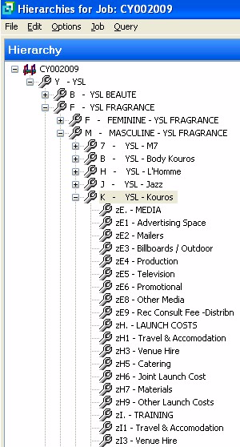
Matching codes in unrelated module provide logical integration
Getting the software to do what it supposedly cannot do
Notes:
DHL, Prochem,

Slide 44
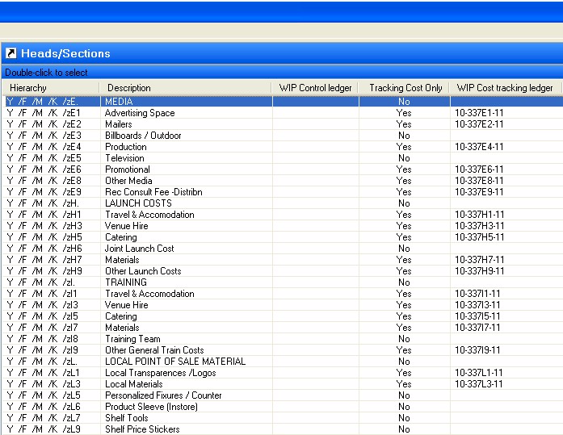
Example of faulty integration
“The &$%^#@% system lost my data”
Notes:
DHL, Prochem,

Slide 45
Factors causing IT failure
Includes process obsession
Weak content engineering is the most tangible factor causing failure
Notes:
NB People
KEEP IT SHORT

Slide 46
The value of technology is determined by the person using the technology
Notes:
A gun is neither good nor bad
If it is held by a person you regard as good and pointed at a person you regard as bad the gun is good
BUT if it is pointed at YOU it is always BAD!

Slide 47
The Business Intelligence
and ERP challenge
Most businesses are NOT making better decisions than they did five years ago despite substantial BI investments -- Gartner 2006
19 out of 20 ERP implementations do not deliver what was promised” – Financial Mail 2003
50% of ERP projects fail – Gartner
Precision strategic content engineering
→ THE MISSING LINK
A HUGE OPPORTUNITY

Slide 48
Exceptionally BAD practice
Huge negative impact on integration, reporting, etc
500528 | Waste Material Consumed
500530 | Loss from valuation of external materials
500540 | Loss from valuation of own materials
500550 | Losses - inventory variance -consignment sale
500560 | Safety Clothing
500565 | Safety Equipment
500570 | Sand & Stone
500575 | Scraper Rope
500580 | Scrapers
500585 | Services
500590 | Signs
500595 | Skips & Cages
500600 | Finished Goods Inventory Offset
500605 | Smelting & Refining
500610 | Production Order Settlement - Variance
500615 | Steel Other
500620 | Steel Sections
500625 | Steel Sheets & Plates
Capital item
Capital item or cost

Slide 49
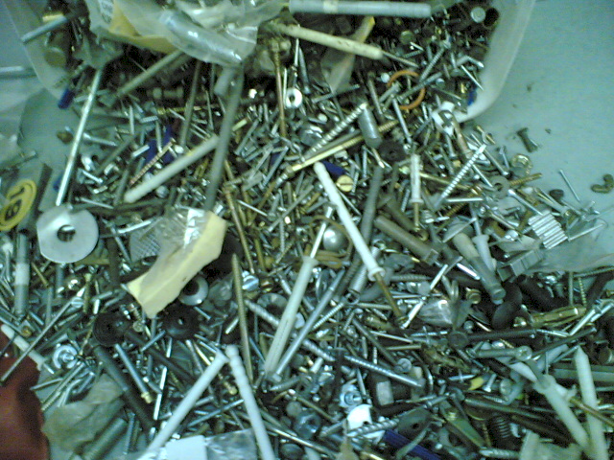
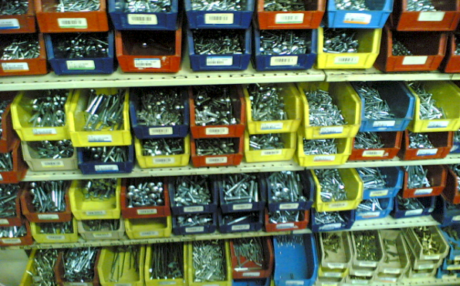
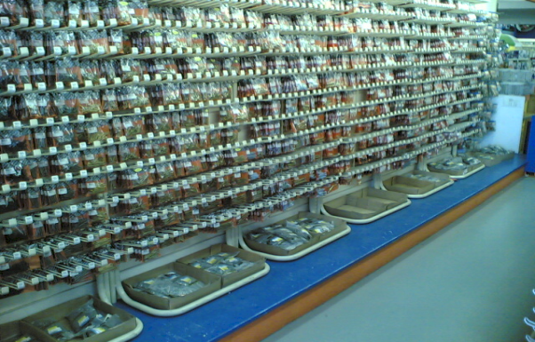
Precision ordered data
Versus …

Slide 50
What is the best way to unscramble spaghetti?
Do NOT scramble it in the first place!

Slide 51
Structure of strategically aligned Chart of Accounts → plant maintenance → inventory → etc
Assets
Assets owned
Assets leased
...
Dep’n assets owned
Dep’n assets leased
...
Liabilities
Income
Expenses
R&M assets
Finance and insurance
assets
...
Plant Maintenance
Materials Management
Investment
E...
D..
... operation
Processing
Marketing and sales
Operational support
Administration
Dividends, taxes, etc
MOBILE PLANT
LHD’s
Dump trucks
Drill rigs
Other off road
LDV’s
etc
Provide for foreseeable growth
Five to ten years

Slide 52
Mapping between modules
Well structured
GL R&M spares expenses
MM plant spares
MOBILE PLANT
Loaders
Dump trucks
Drill rigs
Other off road
LDV’s
etc
MOBILE PLANT
Loaders
Dump trucks
Drill rigs
Other off road
LDV’s
etc

Slide 53
Precision strategic content engineering
IS the missing link
Lack of coding structure and standards
versus
fundamental first principles precision strategic content engineering
Instead of ->
Current
Objective

Slide 54
Business Intelligence
the ideal
Better DECISIONS
Business intelligence solutions
ERP
Strategic Engineered Precision Taxonomies™
The foundation of decision support
The business

Slide 55
Business Intelligence
current reality
Throwing
Money away
Business intelligence solutions
ERP
The business

Slide 56
Business Intelligence
the opportunity
high value highly successful outcomes
Business intelligence solutions
Precision fundamental strategic taxonomies
The foundation of BI – logical translation layer
Years
ERP
Precision strategic business fundamentals
The foundation of decision support
Precision fundamental strategic taxonomy
The foundation of decision support
The business

Slide 57
Value versus precision
A critical consideration
The goal
X
100%
Business value delivered
X Just about every implementation I have ever seen
Practical fundamental strategic taxonomy precision
100%

Slide 58
Critical principle – constraint and opportunity -- cognitive span

Slide 59
Drill down
A function of the content

Slide 60
Cubic business model
A logical taxonomic construct
Every organization has a location logical dimension – where we do what we do
and a functional logical dimension – what we do
These can be plotted on a matrix of function versus location
This is fundamental to the design of a chart of accounts and all other logical components that define the business
There are multiple further dimensions including income, expenditure, personnel, machines, products, etc
Each of these should be described by a fundamental precision strategic taxonomy
This model in the general ledger provides a critical elment of integration

Slide 61
Cubic business model concept
GL or costing module
FUNCTIONAL AXIS
What We Do
LOCATION AXIS
Where We Do What We Do

Slide 62
Financial cube
Essence of integration
Well over 1,000 hours R&D
Projects
etc
People
Products
Assets
Accounts -- financial
Function
Accounts
Location

Slide 63
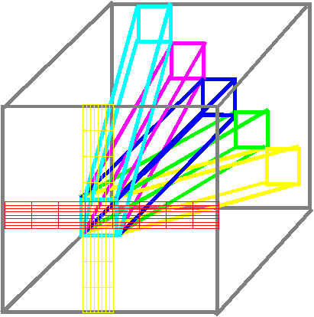
Cubic business model
Locus of integration -- taxonomies
Accounts in the Ledger
Other modules

Slide 64
How integration works around the GL
Other modules

Slide 65
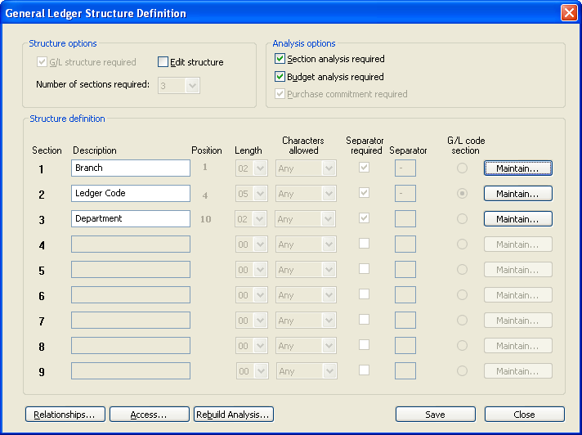
Example of “cubic business model”
In General Ledger
Notes:
DHL, Prochem,

Slide 66
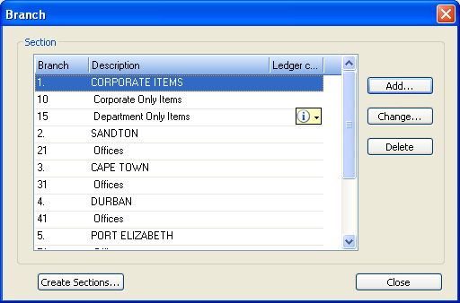
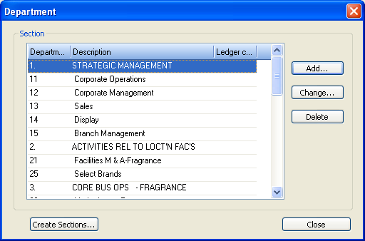
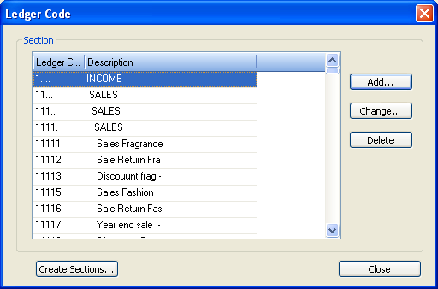
Example of “cubic business model”
Notes:
DHL, Prochem,

Slide 67
Use in acquisitions
Map existing data of newly acquired company onto existing precision strategic taxonomies
Run all available reports against new acquisition within days
Integrate and optimize the new business quickly and efficiently
Use in due diligence investigations also
Function
Accounts
Location
Precision fundamental strategic taxonomies

Slide 68
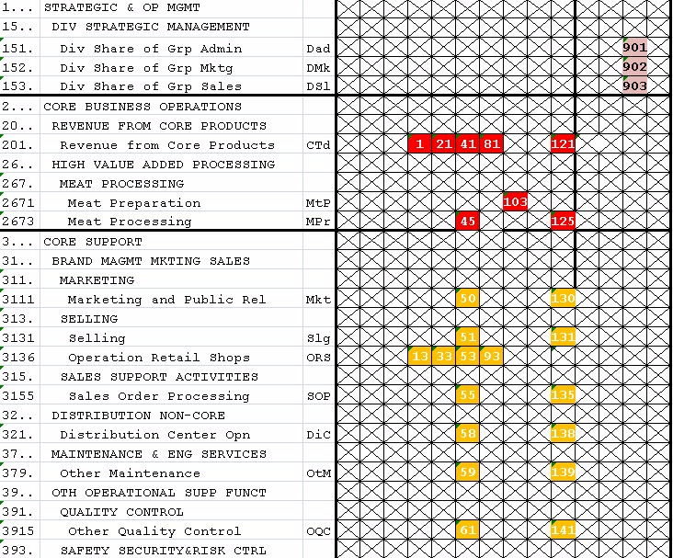
Financial cube
Face of actual cube – top of page

Slide 69
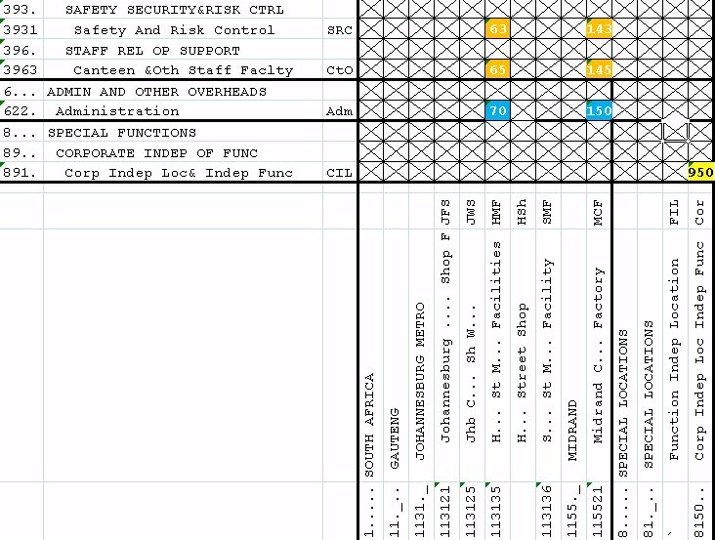
Financial cube
Face of actual cube – bottom of page

Slide 70
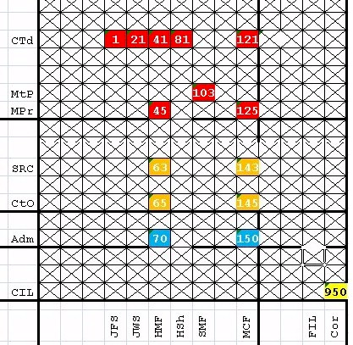
Financial cube
Face of actual cube – portion for illustrative purposes

Slide 71
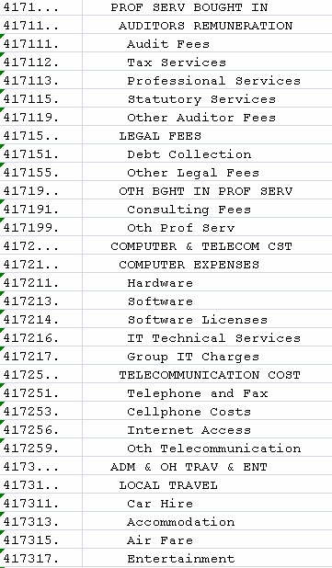
Financial cube
Chart of accounts, the third dimension
Function
Accounts
Location

Slide 72
Financial cube
Matrix analysis of the business
Drop down list on Chart of Accounts linked to matrix view of the cubic model allows any financial measure at any level of detail to be displayed on the matrix

Slide 73
The precision configuration process
Essence of the business
Configuration & integration
Taxonomy config mgmt
Business fundamentals
Basic reports
ERP fundamentals
BI ETL
Dashboards
Develop Hierarchies
Economic & other models
(Assemble)
(Cubes)
Better decisions
THRIVE

Slide 74
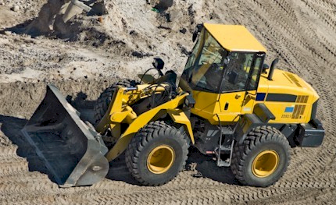
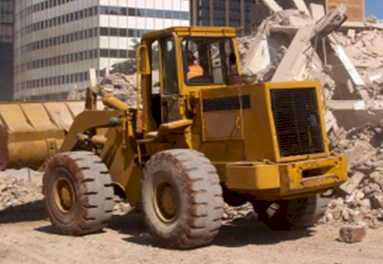
If only I knew exactly what the relative cost of these two machines was I could compete more profitably
Benefits of a comprehensive integrated intelligent information model
Comprehensive integrated economic and operational model
with precision strategic taxonomies
GL
MM
IM
PM
PC
etc
Precision fundamental strategic taxonomies

Slide 75
Characteristics of precision strategic content engineering
Methods and standards
Driven by executive (strategic) decision support requirements
Fundamental first principles → Strategic
Highly structured → Hierarchical
Very specific coding and layout conventions for ease of use
Disciplined code design and maintenance
Massive improvement in management information and decision support
Deliver the often promised but seldom delivered benefits of business ERP, CRM, ECM, BI, IT → business system investments
An opportunity to gear your current investment

Slide 76
Components of Precision Configuration
Software settings
Cubic Business Model™ in the General Ledger
Asset classification
Product / Material / Item classification / catalogue
Classification of Personnel
Other specific classifications
Unique attributes on Products and other classification master data
General record level attribute settings
9. Other configuration settings

Slide 77
Factors for ERP reimplementation success
Strong content engineering is the most tangible factor for success

Slide 78
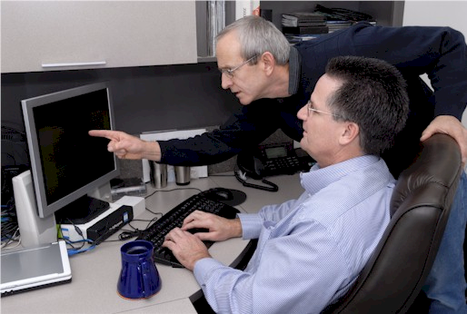
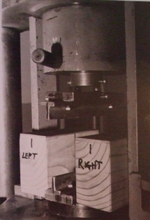
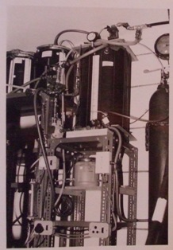
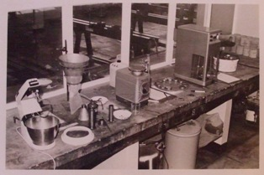
Laboratory
A location where the real world is simulated on a statistically valid representative basis
ALL possible scenarios thoroughly tested
Reports, BI, training, CBT…
AND
Process specification!

Slide 79
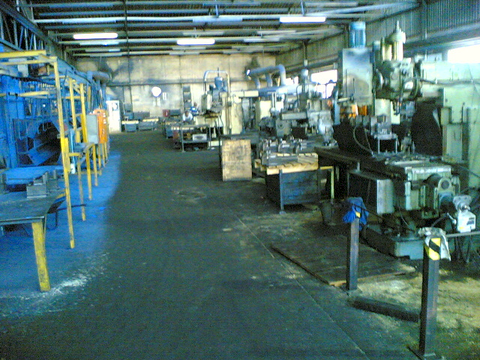
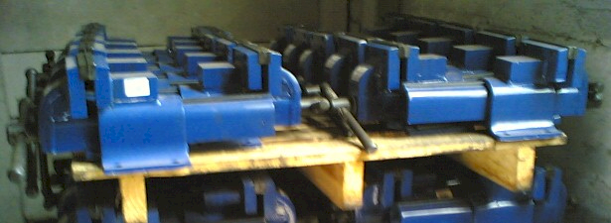
What is an ERP?
REALLY?
A huge precision data processing factory that SHOULD be fed precision data in order to produce precision results (the factory CAN be OLD) ☺
Notes:
DHL, Prochem,

Slide 80
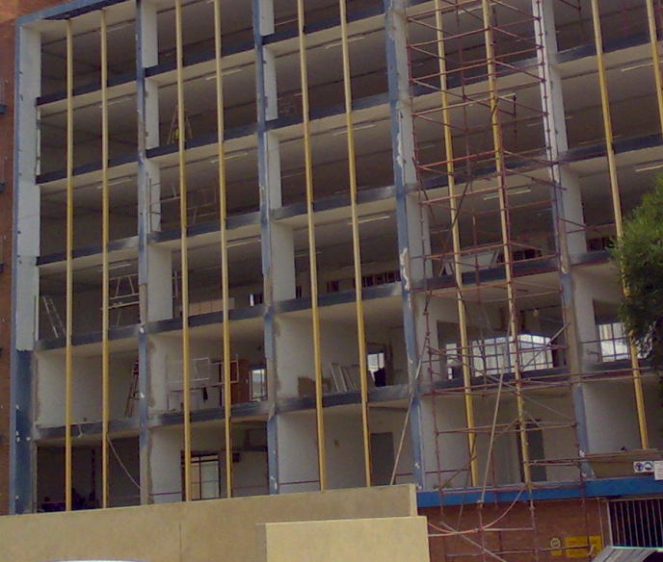
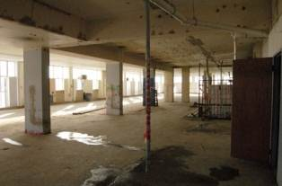
What is an ERP?
Refurbish
Notes:
DHL, Prochem,

Slide 81
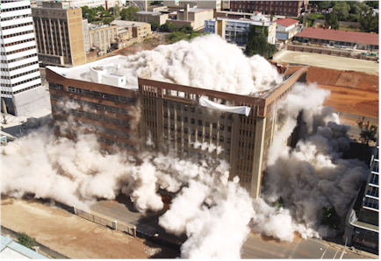
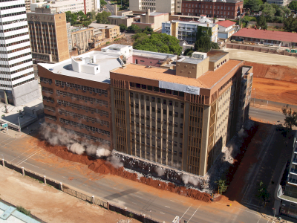
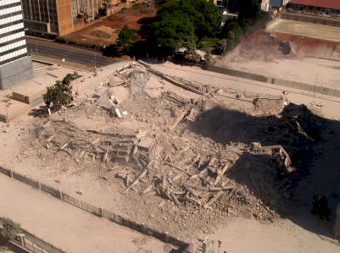
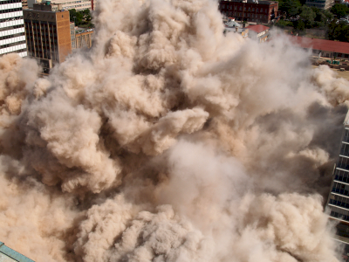
vs Deleting a building
Notes:
DHL, Prochem,

Slide 82
The fundamental requirements for an ERP
The answers to questions I have not yet thought to ask
Enable me to run the business MY way
Accurately model every aspect of my business
Totally integrated solution
Entirely reliable and dependable
Fundamentally support the essence of the business and how it thrives (strategy)
Fully support my day to day operational functions
Including but NOT limited to processes

Slide 83
Summing up -- PROCESS
Business process obsession is killing ERP
It is placing businesses at serious risk
It is only a matter of time before MORE major clients SUE major implementers
There are OTHER aspects of ERP configuration that are MUCH more important than process
Strategic Engineered Precision Configuration based on Precision Taxonomies is THE ERP WAVE OF THE FUTURE

Slide 84
7 Steps to FIX your ERP
CEO take custody
CEO is custodian of the integrated view of the business
therefore custodian of the integrated business information systems (IBIS) comprising
the Enterprise Resource Planning System (ERP)
Data Warehouse (DW)
Business Intelligence (BI)
other systems
high level strategic advisory support
senior staffing
oversight with limited CEO time

Slide 85
7 Steps to FIX your ERP
2. Strategic alignment
define and document the essence of the business and how it thrives
publish and make all personnel aware
evaluate all aspects of operation of ERP getting in the way of the essence of the business
long term plan to fully align IBIS with strategic direction

Slide 86
7 Steps to FIX your ERP
Standards, controls and disciplines
effective ERP operation requires robust and rigorous standards rigorously enforced
engage external specialists to develop the standards
take appropriate measures to implement and apply

Slide 87
7 Steps to FIX your ERP
Configuration audit
comprehensive audit of the configuration of the ERP and the corresponding data in DW
evaluate all code tables, validation lists, master files and other settings
make sure the purpose of every table or list is clearly understood and documented
note deficiencies
formulate long term plan to remediate
note how deficiencies ripple through into DW and BI and formulate plan to rectify

Slide 88
7 Steps to FIX your ERP
Comprehensive suite of taxonomies
define comprehensive suite of Strategic Engineered Precision Taxonomies (SEPT) for new DW
refer Taxonomy Manual
every single validation table or master list should be populated with precision taxonomies in the Data Warehouse – includes
Chart of Accounts
Cubic Business Model
Product Class / Product Master / Material Master / Item Master / etc
Customer Classification
Supplier Classification
etc, etc

Slide 89
7 Steps to FIX your ERP
Data warehouse and business intelligence
clean instance of Data Warehouse
keep the old instance running and build the new Data Warehouse alongside the old one
if you do not have a fully-fledged data warehouse, now is the time to obtain one
high risk and massive project to re-implement ERP – so do NOT do it!!
much lower risk to implement the new taxonomies first in a new Data Warehouse
does require drudge mapping
solves most critical decision support problems (80% of the problem for 20% of the cost)
IF correctly designed and implemented this will deliver exceptionally high value results

Slide 90
7 Steps to FIX your ERP
Progressive refurbishment of ERP
now know what needs to be done to ERP
will take incremental remedial steps in ERP to get DW working adequately
can do limited surgery on the ERP
progressive, pragmatic, incremental remediation of ERP over years
higher value, lower risk and lower cost route to greatly enhanced IBIS (ERP, DW, BI) operation in support of high value strategic decision making

Slide 91
Summing up – Precision Configuration
Excellent high value decisions rely on logical strategically aligned information → the information to thrive
To get executive intelligence OUT you must put executive intelligence IN – “intelligent content”
Precision strategic content engineering IS THE missing link in ERP and IBIS
Requires a significant investment
An ART and a science
Do NOT scrap your current system until you have thoroughly evaluated this
An opportunity for dramatic gearing of your current investment
Better DECISIONS

Slide 92
Questions?
Dr James Robertson PrEng
James A Robertson & Associates
Telephone: ++27-(0)86-111-5409
Cell: 083-251-6644 (preferred)
Fax: ++27-(0)86-540-0178
P O Box 4206, Randburg, 2125, South Africa
www.James-A-Robertson-and-Associates.com
email: James@JamesARobertson.com
LinkedIn: http://za.LinkedIn.com/in/DrJamesARobertsonERPDoctor
Please remember to complete the evaluation forms
Finding the missing pieces of your I.T. and strategy puzzles

